Slide 1

Keele University
Procurement Working Group
Responsible Procurement

Slide 2
Agenda
What is sustainability?
What is sustainable procurement?
The Flexible Framework
NETpositive Procurement – maximising our positive impact
Putting it into practice!
Notes:
And in only half an hour!

Slide 3











What is sustainability?
Notes:
Traditional estates and environmental elements shifting towards non-estates areas (wellbeing, procurement, research).
Main focus at Keele is around carbon and environmental sustainability. This does not restrict the procurement approach as there are other drivers relating to community etc.

Slide 4
Birmingham
Bradford
Bristol
Cambridge
Cardiff
Durham
Edinburgh
Exeter
Glasgow
Imperial College
King’s College
Kingston
Leeds Met
Leeds
Liverpool
Loughborough
LSE
Manchester Met
Manchester
Newcastle
Northampton
NTU
Oxford Brookes
Oxford
Queen Mary London
Sheffield
Southampton
UCL
Warwick
York
Notes:
We looked at environmental/sustainability policies/strategies from these institutions.

Slide 5
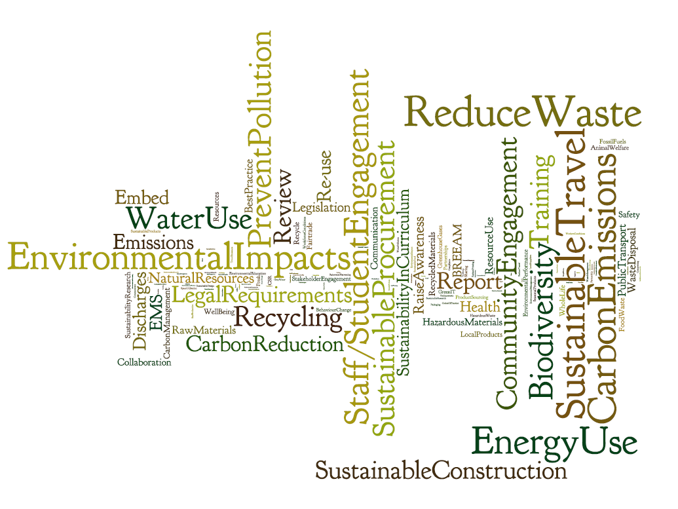
Notes:
And created a wordle of what they contain. Bigger the word; more times it is mentioned.

Slide 6
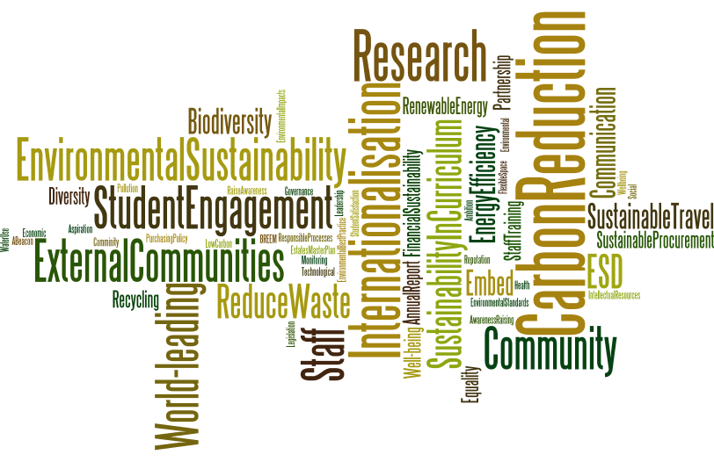
Notes:
Keele version – what your strategy/policy talks about in relation to sustainability.

Slide 7
What is sustainability?
“Sustainability is about how universities do what they do, it is a focus on core business and about taking responsibility for the total impact of their activity. A socially responsible and sustainable university is one that is not only financially viable but takes account of all the positive and negative environmental, social and economic effects it has on society, both now and into the future”

Slide 8
Sustainability Excellence
Is a way of making decisions!
We consider the environmental, social and economic implications
We take a long term perspective
We seek to enhance the positive impact of what we do
We seek to reduce the negative impact of what we do

Slide 9
NETpositive Sustainability
Social Value
Economic Value
Impact
Environmental Impact
Time
Notes:
How we think about it.

Slide 10
So, what is sustainable procurement?

Slide 11
Sustainability Procurement Excellence!
Is a way of making decisions!
We consider the environmental, social and economic implications
We take a long term perspective
We seek to enhance the positive impact of what we do
We seek to reduce the negative impact of what we do

Slide 12
What is sustainable procurement?
Looking for opportunities to reduce the negative impacts and enhance the positive impacts (environmental, social, economic);
  What you buy
  How you buy it
  Who you buy it from

Slide 13
The Flexible Framework
Notes:
Keele aspiration to get to L4.
Other additional benefits beyond sustainability – excellent procurement process and practice, team development, training and comms.

Slide 15
Level 5
Lead
Level 4
Enhance
Level 3
Practice
Level 2
Embed
Level 1
Foundation

Slide 16
Maximising the positive impact of procurement

Slide 17
The Approach
  Step 1 – What goods or services are provided within the commodity code?
  Step 2 – What are the associated impacts?
    Positive and negative, environmental social and economic
  Step 3 – Where are the opportunities in the procurement process to address the issues?
Notes:
The approach we take.

Slide 18
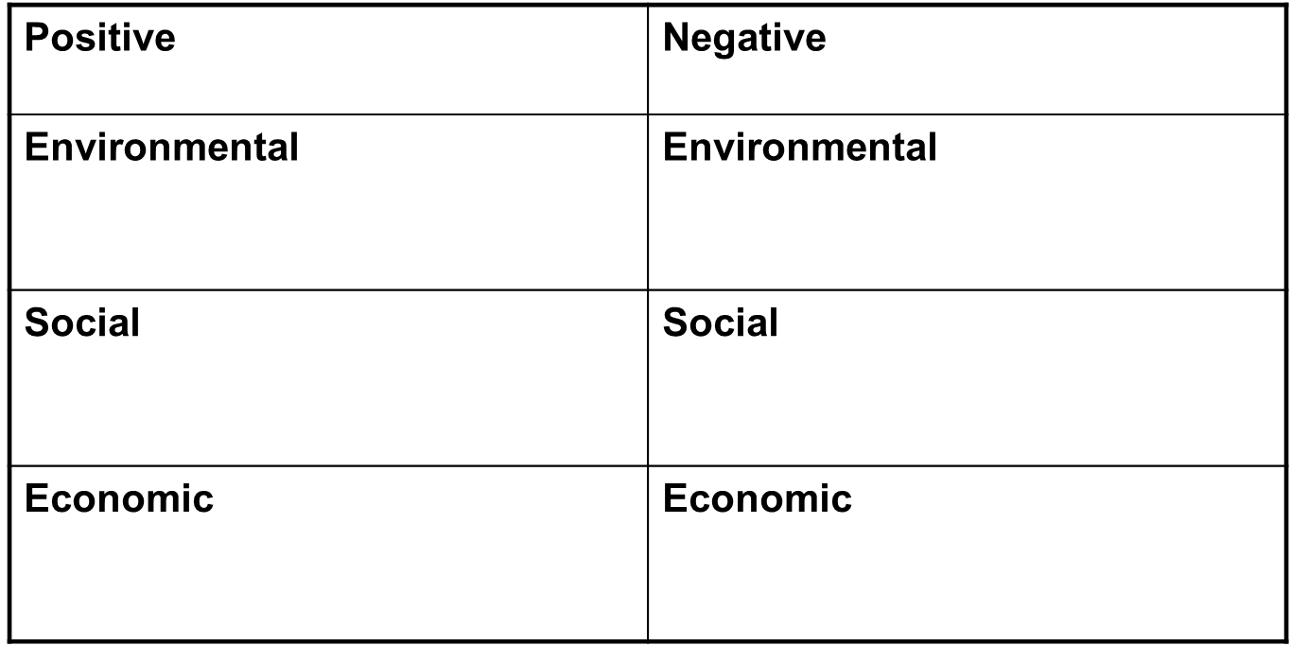
The Approach

Slide 19
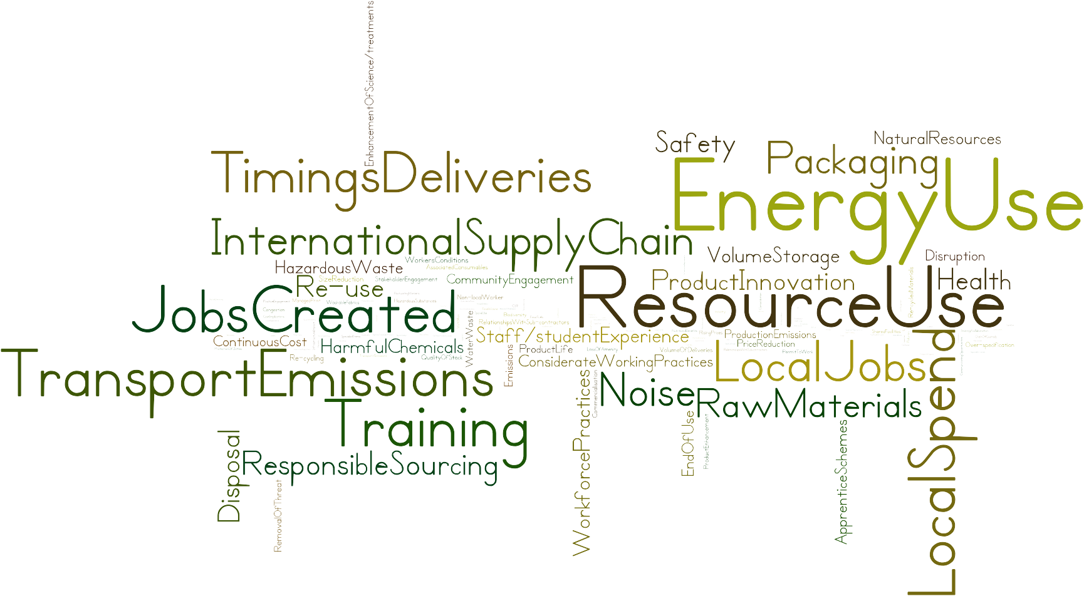
Notes:
Why we take it. Opportunities are mainly NOT reducing environmental negative impacts.

Slide 20
Linking Strategy to Action
Organisational Strategic Intent
Sustainability /Environment Strategy
Procurement Strategy (Incorporating Sustainability)
Commodity Analysis to identify positive and negative impacts
Incorporate impact analysis into procurement process
Supplier Engagement and support
Notes:
Need to connect action with strategic intent for the narrative to make sense.
Also the approach taken to target setting.

Slide 21
Strategic Aims
To contribute positively to the society, economy, culture, health and well-being of the communities we serve
To promote environmental sustainability in all that we do
To transform how we work to ensure that the development is sustainable and delivers world-leading teaching and research
Notes:
Some aims from the new strategic plan.
Very clear mandate – procurement team (with groups like this) working out what it means in practice.
Colleagues around the table likely to be considering what sustainability means in their own context (opportunity here!).
Story or narrative is being developed – this group is part of that.
Example narratives follow>

Slide 22


What does Social Responsibility look like?
ADDRESSING INEQUALITIES
ETHICAL GRAND CHALLENGES
SCHOOLS GOVERNORS INITIATIVE
CULTURAL ACCESS PROGRAMME
THE WORKS
STAFF STEPS TO SUSTAINABILITY
Strategic Priorities
Signature Programmes
Notes:
Social responsibility being delivered via a series of signature programmes across the university.
Procurement is a means to an end not an end in itself but we fit in (responsible processes) and are embedded into bigger picture: Signature Programme (module on responsible procurement)

Slide 23
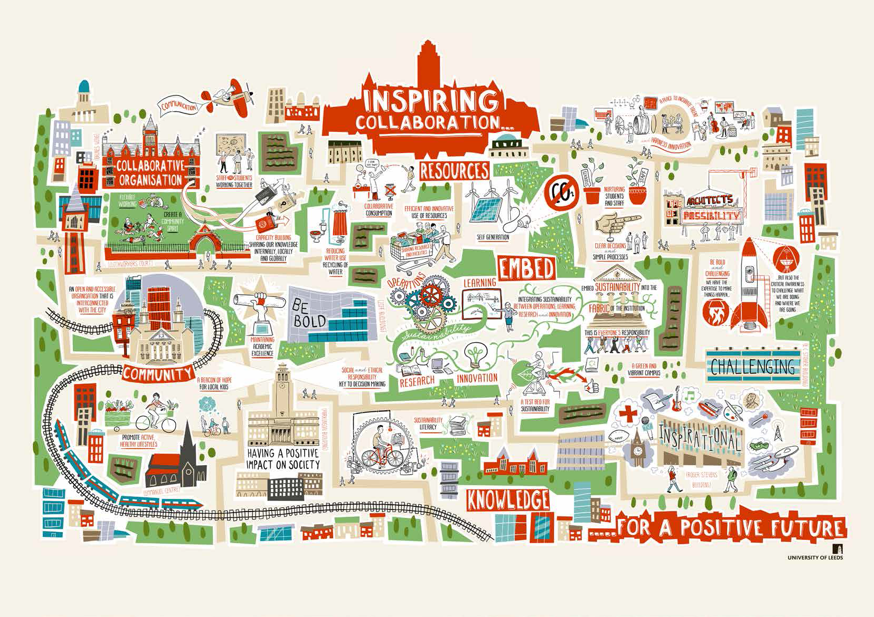
Notes:
Leeds – whole institution approach. Large scale strategy development through consultation. Language shift from traditional environmental sustainability.

Slide 24
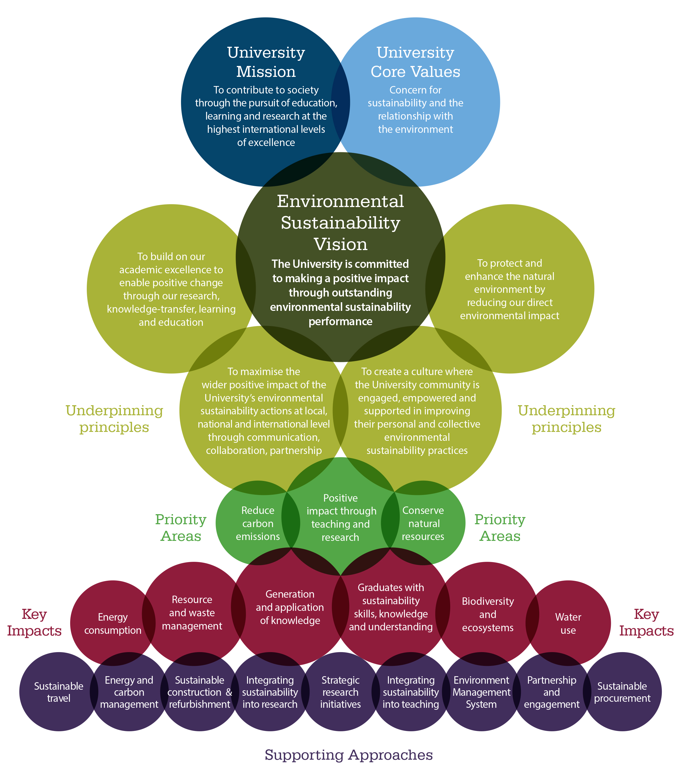
Notes:
Cambridge – more traditional estates-based activity but with stretch into other areas also.

Slide 25
Developing the Keele Narrative:
People
Policy, Strategy and Communications
Procurement Process
Engaging Suppliers
Measurements and results
Notes:
Changes to practice and process?
Supporting the central team?
Supporting the communications.?

Slide 26
Next steps?

